Slide 1
THE
GANBICLE
An online store for GAN speedcubes and gear
Vũ Minh
Web development coursework · 2026
Notes:
Hello, I am Vũ Minh. My project is The Ganbicle, an online store for GAN speedcubes.

Slide 2
About me
1
Where I started
Python is my main language — scripts, logic, problem solving.
2
What I am learning
HTML, CSS and JavaScript. This site is my first real front-end build.
Vũ Minh
Developer & Cuber
3
Why a cube shop
I cube, so I know the products, the vocabulary and what buyers look for.
Age
13
School
THSG
4
The goal
Grade
8A2T
To make it feel like a real shop rather than a school exercise: real products, real prices, real behaviour.
Notes:
Briefly: background in Python, learning front-end, chose a topic I actually know.

Slide 3
What is The Ganbicle?
A complete storefront for one brand of speedcube — browse the range, compare versions, and check out.
37
8
4
2
products in the catalogue
pages, all hand-built
cube sizes, 2x2 through 5x5
themes, light and dark
Everything runs in the browser
The whole catalogue lives in one JavaScript file, and the pages build themselves from it.
Your cart, theme and ratings are remembered with localStorage, so they survive a refresh.
No server, no database, no build step — open index.html and it works.
Notes:
The point: one data file drives every page. No backend at all.

Slide 4
Main pages
Each one shares the same navigation, footer, theme and cart.
1
2
3
4
Home
Cubes
Accessories
Product detail
Logo, best picks, featured cubes, cube finder, contact
Full catalogue with filters, search and sorting
Timers, mats, lubricants and the solving robot
One page per family, with a version picker
5
6
7
8
Cart
Log in / Register
Profile
Timer
Quantities, totals, shipping and checkout
Account forms with a branded side panel
Account details and order history
Scrambles and solve tracking
Notes:
Walk the pages quickly — detail comes on the next slides.

Slide 5
The home page
Logo and identity
Find your cube
A large isometric cube mark built in SVG, drawn from the same path as the navbar icon.
(beta version)
An interactive picker: three questions — size, budget, what matters most — and it recommends a real cube from the catalogue.
Best products
Four hand-picked cubes, one for every size, pinned in code rather than sorted.
48
Featured cubes
answer combinations, every one tested to return an in-stock product
Six product families, chosen automatically by a featured ranking in the data.
Contact
It explains itself, too — when nothing matches a budget it says so instead of failing.
Hours, returns and shipping. The fees come from the same constants the cart charges.
Notes:
Demo the picker live if there is time — it is the most interesting part of the home page.

Slide 6
Browsing the catalogue
Filters, search and sorting all run instantly in the browser — nothing reloads.
Filter
By cube size or accessory type, each showing a live count
Price
A slider that caps the maximum price
Search
Matches name, series, category and tags
Sort
Featured, price, rating or name
Notes:
Mention that ticking a filter updates the count and the grid immediately.

Slide 7
Product pages
The hardest part was that one product often comes in several versions.
The problem
The fix
The GAN16 alone has five finishes. Listing every one separately would flood the shop with near-identical cards.
Variants share a family id, so the shop shows one card reading "From $69.99" with a version count, and the product page offers buttons to switch.
1
Families
2
Ratings
7 families collapse more than 20 versions into 7 cards
Half-star precision, plus visitors can leave their own
3
Pricing
4
Stock
Sale prices show the old price struck through and a percentage off
Sold-out versions are struck through and cannot be added
Notes:
This is the bit worth dwelling on — it is a real data-modelling decision.

Slide 8
Cart and checkout
1
2
3
4
Add
→
Cart
→
Shipping
→
Checkout
Quantity is capped at what is actually in stock
Rows with quantity controls, totals and a running subtotal
$4.95 flat, free over $75 — calculated live
A validated form, then an order reference
The cart remembers itself
Contents are written to localStorage on every change, so closing the tab does not lose the basket. The same store keeps the light/dark preference and any ratings left on products — the shipping figures shown at checkout and on the home page come from a single pair of constants, so they cannot drift apart.
Notes:
Show adding a cube, then refreshing the page to prove the cart survives.

Slide 9
Accounts and extras
Account pages
Log in, register and profile, each with a branded panel beside the form.
Log in
Email and password, remember me, link through to registering
Timer
Register
Five fields with placeholders and a discount offer
A practice timer with official-style scrambles and solve history, so the site is somewhere to shop and somewhere to train.
Profile
Account details and recent orders — interface only for now
Front-end only. Real sign-in needs a server — anything kept in the browser can be read and edited by the person using it.
A side feature, not the main project.
Notes:
Keep the timer short — one sentence, move on.

Slide 10
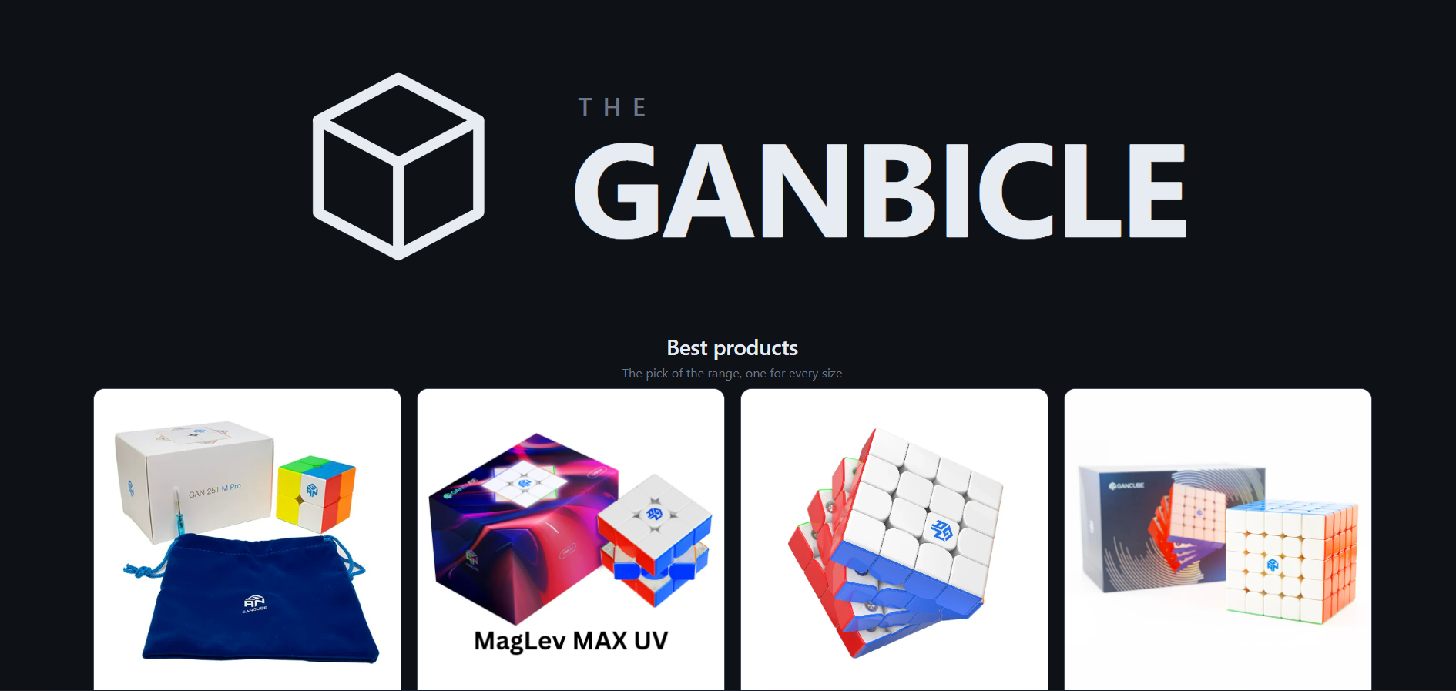
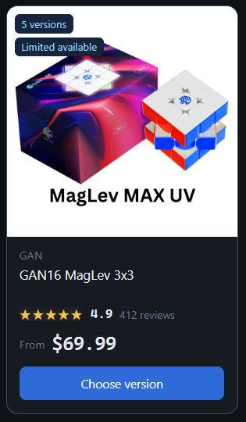
Gallery
Home page
Product card
Notes:
Point out the version badge and the From price - that is the family grouping at work.

Slide 11
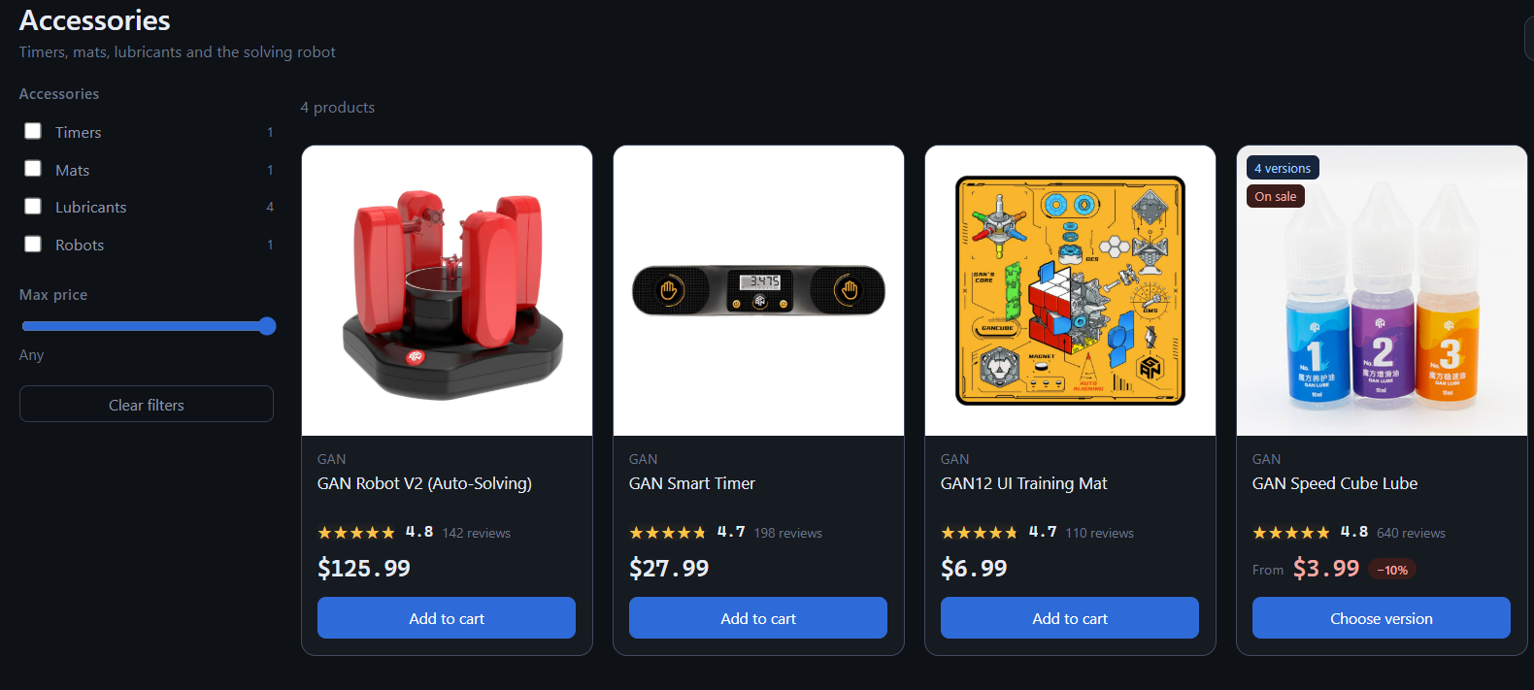
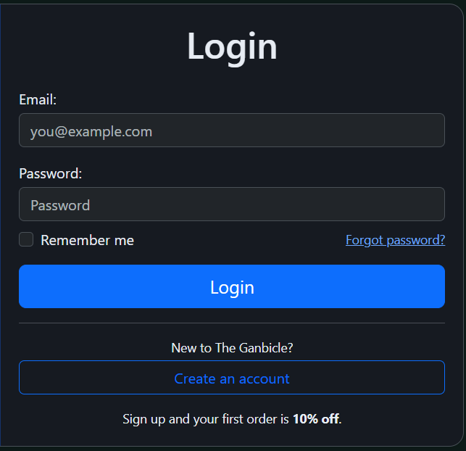
Gallery
The Accessories Shop
Login page
Notes:
The login form is front-end only - worth saying so before anyone asks.

Slide 12
LIVE WALKTHROUGH
DEMO
Notes:
Switch to the browser and walk through the site.

Slide 13
Pros and cons
An honest look at what the build-it-all-in-the-browser approach gets me, and what it costs.
What works well
What it cannot do
One file, whole shop
Accounts are not real
Add a product once and it shows up on the home page, the shop, search and its own page.
The forms look right, but nothing is stored or checked. That needs a server.
Nothing to install
Orders go nowhere
No server and no database. Open index.html and it runs.
Checkout shows an order reference, then forgets it.
It remembers you
One browser only
Cart, theme and ratings all survive a refresh.
Clear the browser and the cart is gone. Nothing syncs between devices.
Fits any screen
Editing means code
Responsive layout, with a light and a dark theme.
Prices and stock live in a file, so there is no admin page.
Notes:
Be straight about the limits - knowing them is part of the work.

Slide 14
What's next
The pieces already in place, and what each one still needs.
1
Real accounts
2
Connect the profile
The profile page is built and waiting. Storing users and checking passwords needs a server — it cannot be done safely in the browser.
The page exists but nothing links to it yet. It needs a nav entry and somewhere for the login form to send people.
3
Compare two cubes
4
Fill the empty shelves
Every product already carries a specs table. Putting two side by side with the differences marked would help people choose without opening two tabs.
Minx, Shape Mods and Bags are already in the filter lists with no products behind them. The structure is there; the catalogue is not.
Notes:
Frame these as the next steps, not as gaps — the structure is already there for each.

Slide 15
Thank you
The Ganbicle · Vũ Minh
Notes:
Thank the room and open for questions.

